Slide 1
CAPSTONE PROJECT
PLAYSTORE APP REVIEW ANALYSIS
Presented By:
1. Thirumalai S –THANTHAI PERIYAR GOVT INSTITUTE OF TECHNOLOGY- CIVIL DEPARTMENT

Slide 2
OUTLINE
Problem Statement
Proposed System/Solution
System Development Approach
Algorithm & Deployment
Result
Conclusion
Future Scope
References

Slide 3
PROBLEM STATEMENT
The Play Store apps data has enormous potential to drive app-making businesses to success. Actionable insights can be drawn for developers to work on and capture the Android market. Each app (row) has values for category, rating, size, and more. Another dataset contains customer reviews of the android apps. Explore and analyze the data to discover key factors responsible for app engagement and success.

Slide 4
PROPOSED SOLUTION
The proposed solution in Play Store review analysis involves leveraging various data analysis techniques to extract valuable insights from user reviews and ratings, aiming to understand user sentiment, identify areas for improvement, and drive app success. Here's an overview of the proposed solution:
1.Data Collection and Preprocessing
2.Sentiment Analysis
3.Topic Modeling
4.Feature Engineering
5.Correlation Analysis
6.Insights Generation
7. Visualization and Reporting
8. Continuous Monitoring and Improvement

Slide 5
SYSTEM APPROACH
Hardware Requirements:
Processor: A multi-core processor (e.g., Intel Core i5 or higher, AMD Ryzen 5 or higher) to handle data processing tasks efficiently.
Memory (RAM): At least 8GB of RAM, preferably 16GB or more, to handle large datasets and complex analysis operations.
Storage: Sufficient storage space (SSD recommended for faster data access) to store datasets, software, and analysis results. A minimum of 256GB SSD is recommended.
Graphics Card: A dedicated graphics card is not necessary for basic data analysis tasks but can improve performance for visualization and machine learning tasks.
Internet Connection: A stable internet connection is required for data collection, software updates, and accessing online resources

Slide 6
ALGORITHM & DEPLOYMENT
Python: Python is one of the most popular programming languages for data analysis due to its versatility and rich ecosystem of libraries. Some key libraries for data analysis in Python include:
Pandas: For data manipulation and analysis, providing data structures like DataFrames.
NumPy: For numerical computing and array operations.
Matplotlib and Seaborn: For data visualization.
Scikit-learn: For machine learning tasks such as classification, regression, clustering, and dimensionality reduction.
NLTK and spaCy: For natural language processing tasks.
Statsmodels: For statistical modeling and hypothesis testing.

Slide 7
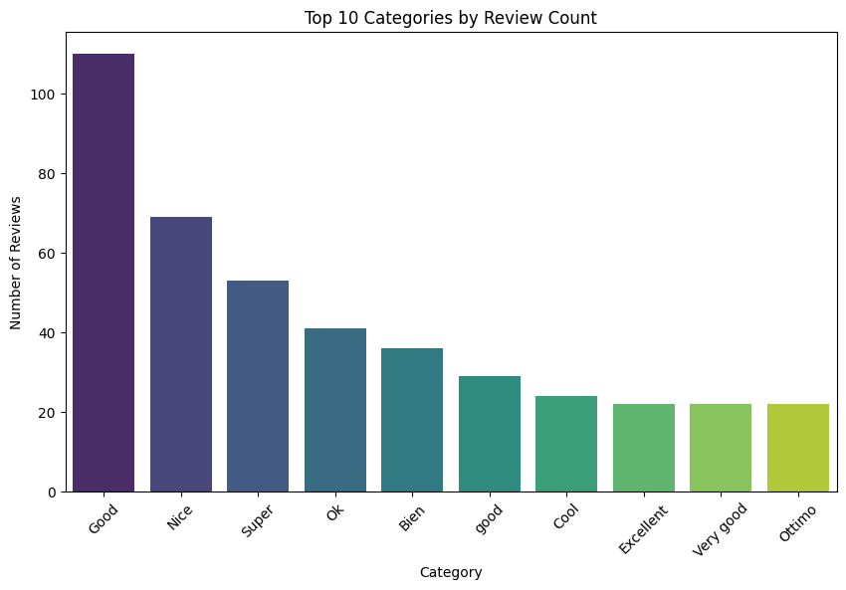
RESULT

Slide 8
CONCLUSION
In conclusion, understanding and leveraging key factors such as category selection, app rating, size optimization, and customer reviews are essential for driving app engagement and success in the competitive Android market. By incorporating these insights into their app development and marketing strategies, developers can enhance user satisfaction, increase app visibility, and ultimately achieve greater success in the Play Store.

Slide 9
FUTURE SCOPE
The future scope for data analysis is vast and promising, with advancements in technology, data collection methods, and analytical techniques opening up new opportunities for various industries and domains

Slide 10
REFERENCES
https://github.com/vigneshmuthuvelan

Slide 11
THANK YOU

